Slide 1



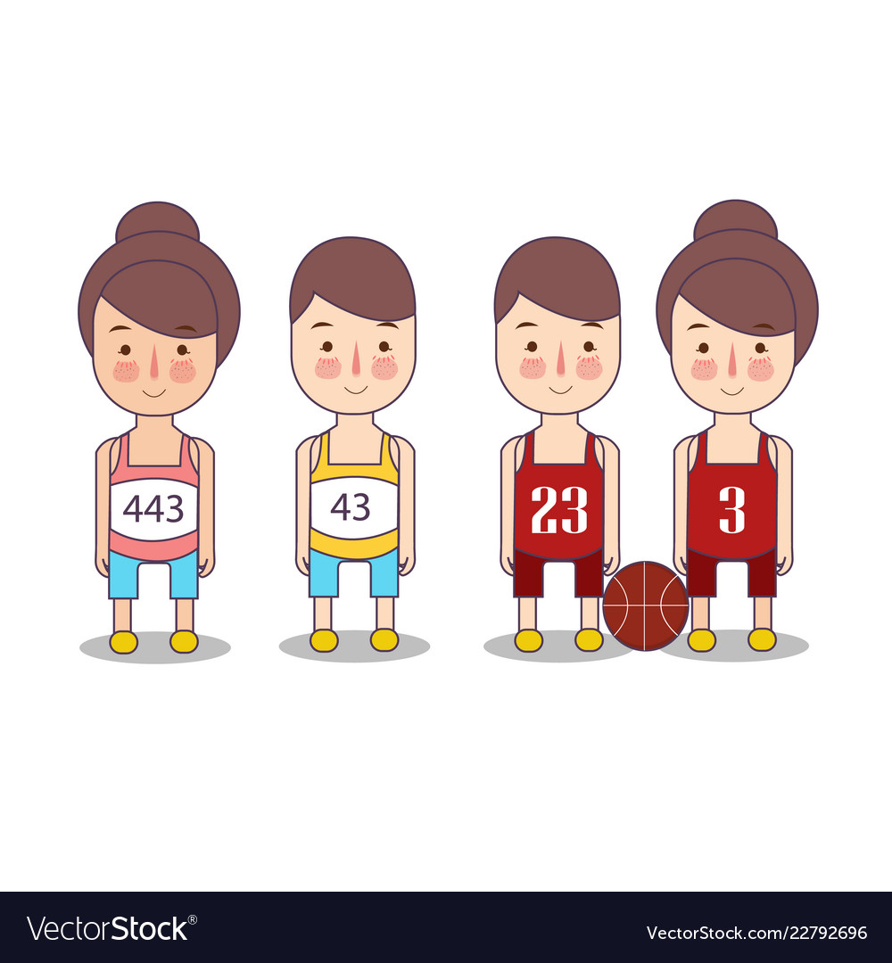
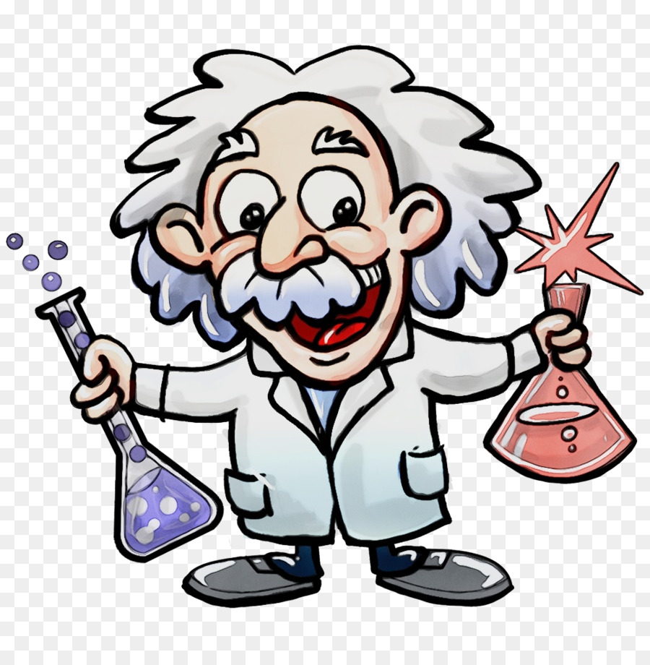

Fun Facts

Slide 2

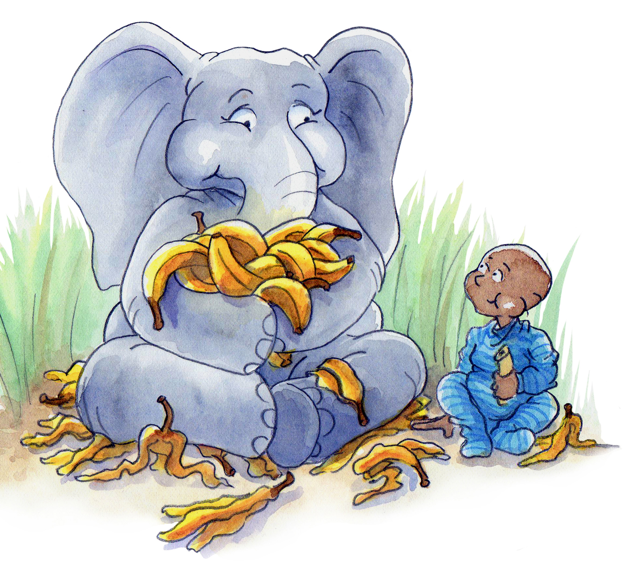

Fun Elephant Facts:-
There are two types of elephant, the Asian elephant and the African elephant
The elephant’s trunk is able to sense the size, shape and temperature of an object. An elephant uses its trunk to lift food and suck up water then pour it into its mouth.
An elephant’s trunk can grow to be about 2 meters long and can weigh up to 140 kg. Some scientists believe that an elephant’s trunk is made up of 100,000 muscles, but no bones.
Elephants are the largest land-living mammal in the world.
Elephants have large, thin ears. Their ears are made up of a complex network of blood vessels which help regulate their temperature. Blood is circulated through their ears to cool them down in hot climates.
Elephants are the largest land-living mammal in the world.

Slide 3



Fun Cat Facts:
A group of cats is called a clowder, a male cat is called a tom, a female cat is called a molly or queen while young cats are called kittens.
Cats can be lethal hunters and very sneaky, when they walk their back paws step almost exactly in the same place as the front paws did beforehand, this keeps noise to a minimum and limits visible tracks.
Cats have powerful night vision, allowing them to see at light levels six times lower than what a human needs in order to see.
Cats conserve energy by sleeping for an average of 13 to14 hours a day.

Slide 4


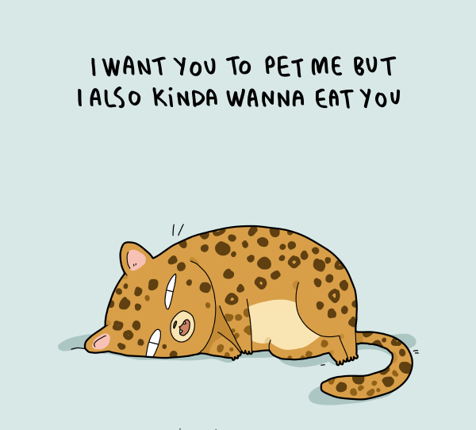
Fun Tiger Facts:
The tiger is the biggest species of the cat family.
Many subspecies of the tiger are either endangered or already extinct. Humans are the primary cause of this through hunting and the destruction of habitats.
A group of tigers is known as an ‘ambush’ or ‘streak’.
Rare white tigers carry a gene that is only present in around 1 in every 10000 tigers.
Tigers can easily jump over 5 meters in length.
Various tiger subspecies are the national animals of Bangladesh, India, North Korea, South Korea and Malaysia.
Tigers that breed with lions give birth to hybrids known as tigons and ligers.

Slide 5



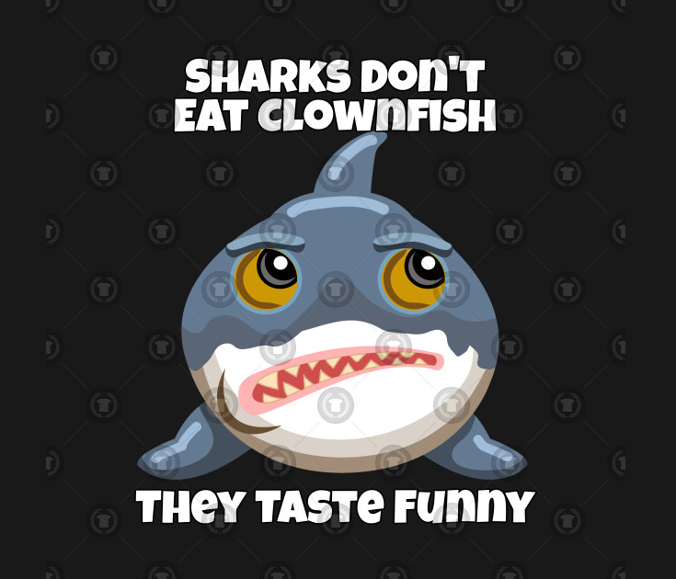
Fun Shark Facts:
Sharks do not have a single bone in their bodies. Instead they have a skeleton made up of cartilage; the same type of tough, flexible tissue that makes up human ears and noses.
Some sharks remain on the move for their entire lives. This forces water over their gills, delivering oxygen to the blood stream. If the shark stops moving then it will suffocate and die.
Sharks have outstanding hearing. They can hear a fish thrashing in the water from as far as 500 meters away!
If a shark was put into a large swimming pool, it would be able to smell a single drop of blood in the water.
A pup (baby shark) is born ready to take care of itself. The mother shark leaves the pup to fend for itself and the pup usually makes a fast get away before the mother tries to eat it!

Slide 6

Fun Octopus Facts
An octopus has a hard beak, like a parrot beak, which they use to break into and eat their pray such as crabs and shellfish.
Octopuses are believed to be highly intelligent compared to other invertebrates.
Octopuses have three hearts.
A last ditch defense is for the octopus to shed a tentacle similar to how a gecko or lizard can discard a tale. An octopus is able to regenerate a lost tentacle.

Slide 7
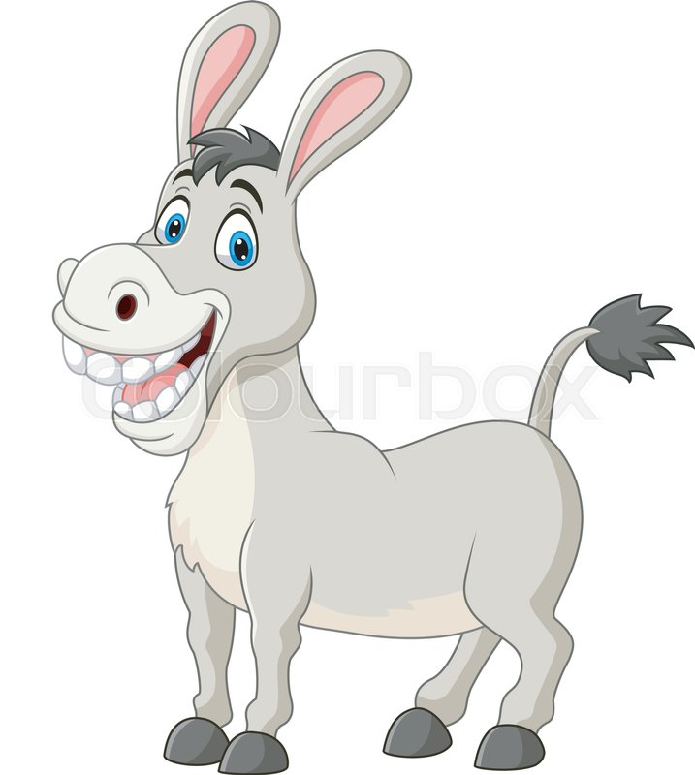
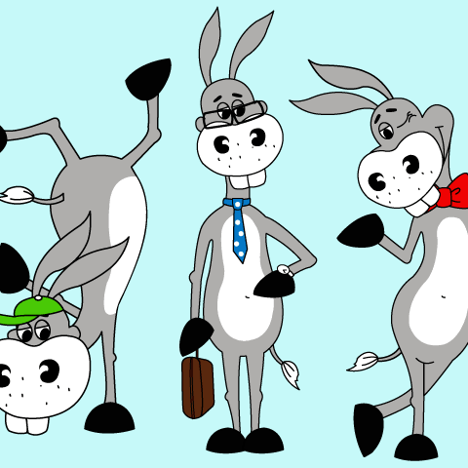

Fun Donkey Facts:
Donkeys can live for over 50 years
Donkeys are very strong and intelligent
A donkey is stronger than a horse of the same size.
Donkeys have an incredible memory – they can recognize areas and other donkeys they were with up to 25 years ago.
Donkeys are more independent in their thinking than horses and will reason, then make decisions based on their safety.

Slide 8


Fun Piggy Facts
Think that pigs are slow and lumbering? As it turns out, they’re not at all! Adult pigs can run at speeds of up to 11mph, or in other words, they can run a seven-minute mile. Could you do any better?
A pig's squeal can be as loud as 115 decibels – that’s 3 decibels higher than the sound of a supersonic airliner.
And when they’re not squealing, they’re talking. Pigs communicate constantly with each other, and more than 20 different vocalizations have been identified; from wooing a mate to saying ‘I’m hungry!”
They may be indiscriminate eaters, but pigs are also highly intelligent and incredibly social animals.

Slide 9



Facts about Humans
The brain cannot feel pain.
Did you know eating cheese at the end of a meal can help neutralise the acids in your mouth and reduce the chance of tooth decay.
Your brain is more powerful, more complex and more clever than any computer ever built.
The human brain is over three times as big as the brain of other mammals that are of similar body size.
Did you know the smallest bone in the body is the stirrup, deep inside the ear, which is about the size of a grain of rice.

Slide 10
Links:-
How Electric Transmission Works.
https://www.youtube.com/watch?v=qjY31x0m3d8&t=199s
What is Hydraulic Jump.
https://www.youtube.com/watch?v=7tjf8HWiR3Y&list=PLTZM4MrZKfW_XJht-K7a9_egIsFqze0nQ
How do Car Engine Works.
https://www.youtube.com/watch?v=zA_19bHxEYg
The Sun
https://www.youtube.com/watch?v=RzkJkEKV8Yk

Slide 11
Links
The Scale of Solar System.
https://www.youtube.com/watch?v=Kj4524AAZdE
What is Time Dialation?
https://www.youtube.com/watch?v=yuD34tEpRFw
What is DNA?
https://www.youtube.com/watch?v=6368Y-OfU9U

Slide 12
Links:
What is Evolution?
https://www.youtube.com/watch?v=xX_-mM6Lx9I
ATOM
https://www.youtube.com/watch?v=jMW_0Ro6b5c
How many senses do we have?
https://www.youtube.com/watch?v=osChE163jJQ

Slide 13
Links:
Milky Way
https://www.youtube.com/watch?v=QIhO9IaLAg8
Climate Zone
https://www.youtube.com/watch?v=5tC8OOxOFEk
Big Bang Theory
https://www.youtube.com/watch?v=GncYOf29uc4

Slide 14
Links:
How do nuclear power plant work?
https://www.youtube.com/watch?v=R7WPEYGr1Vs&t=4s
How deep is Ocean?
https://www.youtube.com/watch?v=UwVNkfCov1k
How wifi and cell phone work?
https://www.youtube.com/watch?v=kxLcwIMYmr0

Slide 15
Link
Physical and Chemical Changes
https://www.youtube.com/watch?v=x49BtB5dOwg
Invention of Computer Programming Language
https://www.youtube.com/watch?v=Wchru8alhaE
Magnetism
https://www.youtube.com/watch?v=yXCeuSiTOug

Slide 16
Links
How Rockets Work
https://www.youtube.com/watch?v=jI-HeXhsUIg
Everything is chemical
https://www.youtube.com/watch?v=7ej_UbREGns
What is Artificial Intelligence?
https://www.youtube.com/watch?v=mJeNghZXtMo

